Slide 1


CrickInfo
Project Presentation
SRI LANKA CRICKET SQUAD SELECTOR
TEAM NAME - ALGO RANGERS
TEAM NUMBER 10

Slide 2

Our Team
22ug1-0323 W.G.K.C. De Mel
22ug1-0010 T.H.R C. Nirosha
22ug1-0013 T.H.R C. Nadeesha
22ug1-0082 H.V. Rashini Nilumika
22ug1-0233 T.T. Jayasekara
22ug1-0460 A.V.D. Amarathunga
22ug1-0459 S.S.D. Fernando
22ug1-0281 P.N.M.S.S. Wijesinghe
22ug1-0471 K.K.P. Bimsara
22ug1-0472 K.G.P. Kavishka
Team Algo Rangers

Slide 3

Project Overview
GOAL
Build a web application that recommends an optimal Sri Lankan cricket squad using machine learning
Why this project?
Manual selection is time-consuming and subjective. Our system uses data to assist selectors with objective, performance-based squad recommendations.

Slide 4

Problem Statement
what’s the challenge?
Cricket squad selection is often subjective and manually done by selectors.
Factors like player form, match conditions, and role balance are not always weighted consistently.
Manual selection can lead to biases, inefficiencies, or lack of transparency.
.

Slide 5

Project Objectives
Apply machine learning for data-driven player selection
Create an end-to-end ML-powered web system
Design a clean and responsive user interface
Ensure modular and maintainable code
Enable scalability for future sports analytics projects

Slide 6

System Features
Match Type
Player Stats
Input match type (ODI, T20, Test), pitch conditions
Display player stats (avg, economy, strike rate, etc.
Automatic squad generation
API
Automatic squad generation using trained ML models
RESTful API access

Slide 7

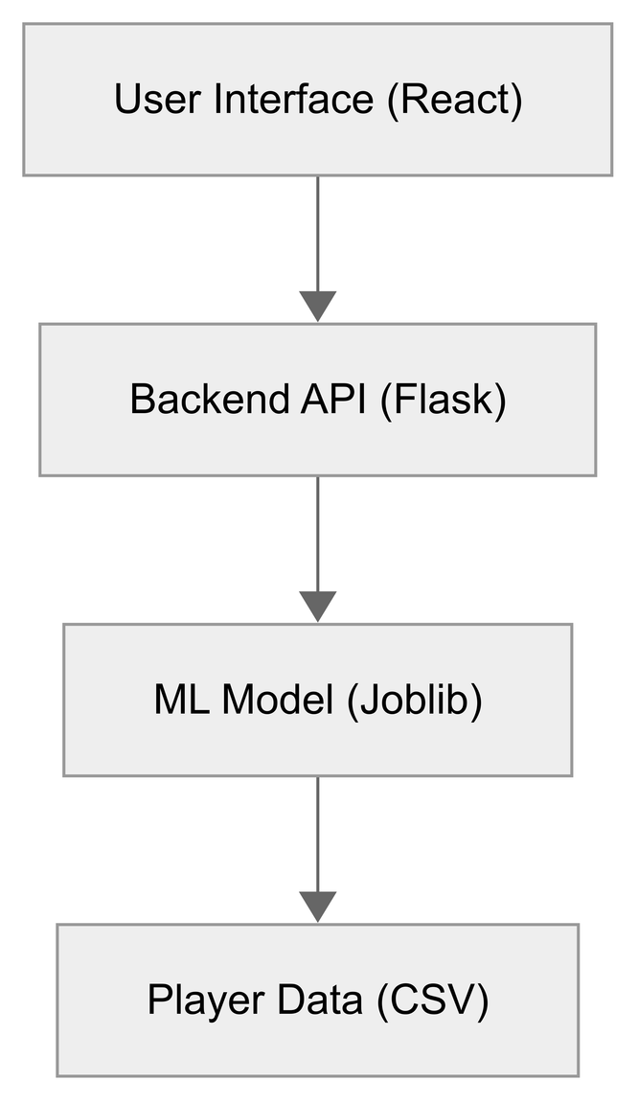
System Architecture Diagram

Slide 8




Machine Learning Pipeline
Input Features
Match type, pitch type, venue
Player performance metrics (batting avg, bowling economy, recent form)
Role: batsman, bowler, all-rounder
Model Used
Random Forest
XGBoost
Output
Recommended squad (11-15 players)
Role distribution maintained

Slide 9

Model Evaluation
Metrics
Tools
Result
Scikit-learn
Joblib/Pickle for model storage
Accuracy
Precision
Recall
~85–90% prediction accuracy on validation dataset
Balanced role distribution in team output

Slide 10
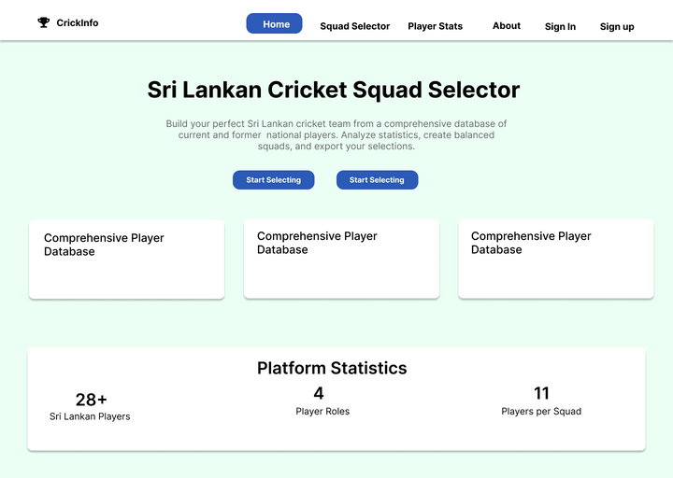
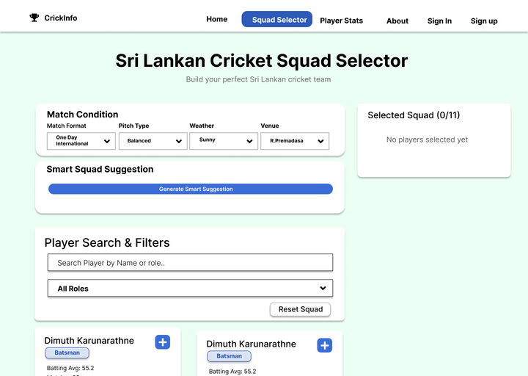
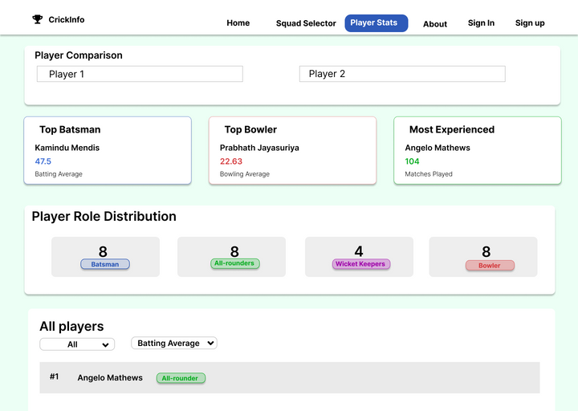
User Interface (UI)
Responsive & user-friendly design
Form to select match type, pitch
condition, etc
List of selected players with stats

Slide 11
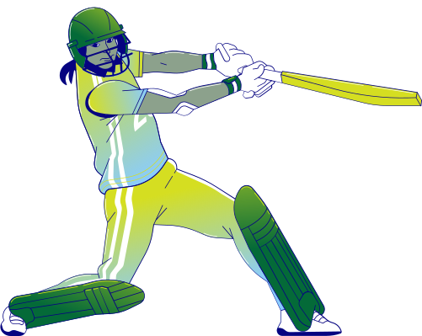

Backend & API
Framework:- Flask or FastAPI
Endpoints:
Predict - Accepts inputs and returns predicted squad.
Players - Fetches player stats.
Dataflow:-
Frontend → API → Model → Response → UI

Slide 12
Challenges Faced
Incomplete data for some players
Aligning player roles across different match formats
Ensuring fairness in player selection
Keeping the model explainable and unbiased

Slide 13

Future Improvements
Add fitness & injury tracking
Real-time performance updates
Use deep learning for form prediction
Extend to women’s teams or international teams
Add voice-based UI for accessibility

Slide 14
Thank you very much!
PRESENTED BY ALGO RANGERS
TEAM NUMBER 10

